Slide 1
Man is to Computer Programmer as Woman is to Homemaker? Debiasing Word Embeddings (Bolukbasi, T., Chang, K. W., Zou, J., Saligrama, V., & Kalai, A. 2016)
NLP masters 최상혁 08 May 2021

Slide 2
Contents
0. Abstract
1. Introduction
2. Related Work
3. Preliminaries
4. Gender stereotypes in word embeddings
5. Geometry of Gender and Bias 5.1. Identifying the gender subspace 5.2. Direct bias 5.3. Indirect bias
6. Debiasing algorithms
7. Determining gender neutral words
8. Debiasing results
9. Discussions

Slide 3
0. Abstract

Slide 4
0. Abstract
1) Gender bias is shown to be captured by a direction in the word embedding. Gender bias를 담고있는 direction이 있더라.
2) Gender neutral words are shown to be linearly separable from gender definition words in the word embedding. Gender neutral words => 의사, 간호사, … Gender definition words => 엄마/아빠, he/she, …
We provide a methodology for modifying an embedding to remove gender stereotypes while maintaining desired associations.

Slide 5
1. Introduction

Slide 6
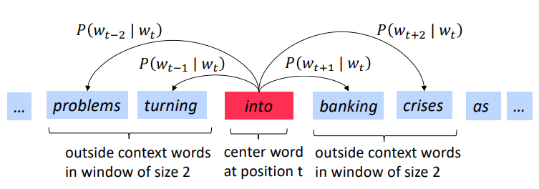

1. Introduction
Word2Vec
Image from: https://web.stanford.edu/class/archive/cs/cs224n/cs224n.1194/

Slide 7

1. Introduction
Word2Vec
Image from: https://web.stanford.edu/class/archive/cs/cs224n/cs224n.1194/
“Word embeddings not only reflect such Stereotypes
but can also amplify them (e.g. search engine)”

Slide 8
4. Gender stereotypes in word embeddings
[Occupational stereotypes] whether the embedding has stereotypes on occupation words
[Analogies exhibiting stereotypes] whether the embedding produces analogies that are judged to reflect stereotypes by humans
Notes:
여기선 아주 간단한 방법으로 word2vec에 gender stereotype 이 존재함을 보임

Slide 9
4. Occupational stereotypes
10명의 crowd-workers가 각 occupation word에 대해 gender stereotype이다/아니다를 판단 ⇒ 0~10 scale의 human annotated stereotypicality를 얻음 (e.g. homemaker: 8, maestro: 2)
The projection of the occupation words onto the she-he axis is strongly correlated with human annotated stereotypicality. (Spearman ρ =0.51)
The geometric biases of embedding vectors is aligned with crowd judgement of gender stereotypes
Extreme “she” occupations “she”와 가까운 직업 단어들 homemaker / nurse / receptionist / librarian / socialite / hairdresser / nanny …
Extreme “he” occupations “he”와 가까운 직업 단어들 maestro / skipper / protégé / philosopher / captain / architect / financier / …

Slide 10
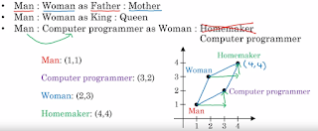
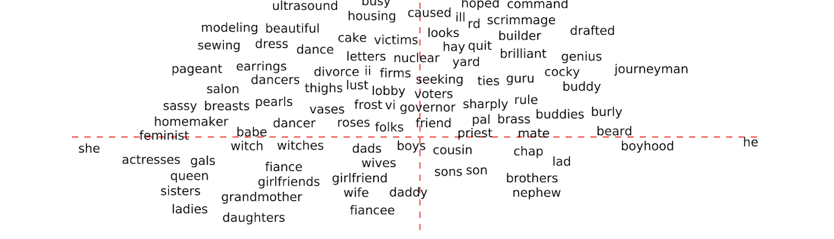
4. Occupational stereotypes
Image from: http://hari-sriblog.blogspot.com/2019/04/man-is-to-computer-programmer-as-woman.html
Notes:
Woman-Man이긴 한데 she-he라고 생각하고 봐주세요

Slide 11

4. Analogies exhibiting stereotypes
a good analogy pair to be close to parallel to the seed direction while the two words are not too far apart in order to be semantically coherent.
두 단어의 의미가 적당히 비슷하면서 she-he direction과 평행한 word pair
seed pair of words (a, b) = (she, he)
Score가 높은 순대로 총 150개의 pair를 생성
crowd sourcing으로 rating. (이 word pair가 gender stereotype을 보이고 있나요?)
150개 pairs의 분류 결과: 29 gender stereotype pairs (e.g. midwife-doctor) 72 gender appropriate pairs (e.g. grandmother-grandfather) (나머지는 미분류)
Notes:
이런식으로 stereotyp을 어느 정도 갖고 있음을 먼저 보인 것!

Slide 12
4. Analogies exhibiting stereotypes
👇“Gender stereotype을 보이는” 단어들 👇
Gender stereotype she - he analogies (gender neutral words) sewing - carpentry / housewife - shopkeeper / nurse - surgeon / softball – baseball Occupation이 아닌 다른 단어들의 pair도 찾아냈다.
👇“정의 자체가 gender specific 한” 단어들 👇
Gender appropriate she - he analogies (gender definition words) queen - king / sister - brother / mother - father / waitress - waiter / convent-monastery

Slide 13
5. Geometry of Gender Bias
앞에선 단순히 she-he axis로 살펴본 것이고
여기서는 gender subspace를 정의해서 bias를 보다 robust 하게 측정
“we shall aggregate across multiple paired comparisons.”

Slide 14
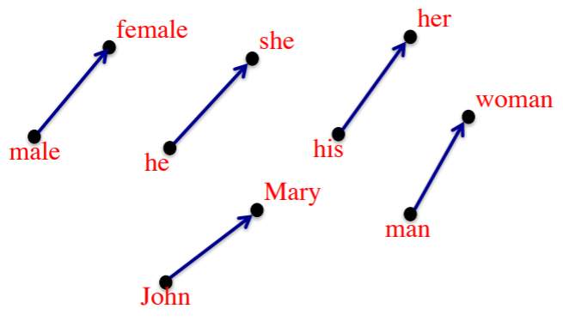
5.1. Identifying the gender subspace
Select 10 pairs of words that reflect concept (gender) opposites.
https://drive.google.com/file/d/1IxIdmreH4qVYnx68QVkqCC9-_yyksoxR/view
Notes:
정답 단어들과 얼마나 비슷한지를 측정하면 되기 때문에 C_w_i에 대해서만 Probability를 계산하면 된다.

Slide 15
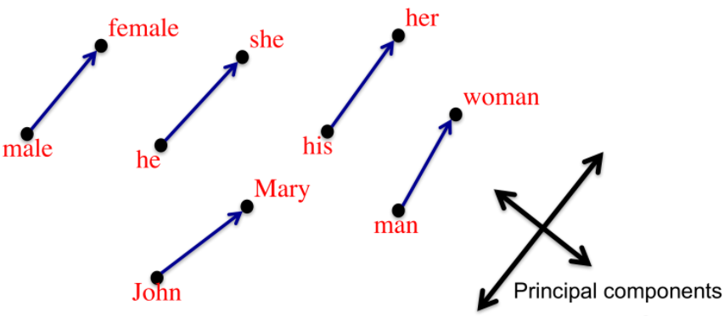
5.1. Identifying the gender subspace
Select 10 pairs of words that reflect concept (gender) opposites.
https://drive.google.com/file/d/1IxIdmreH4qVYnx68QVkqCC9-_yyksoxR/view
Notes:
실제로는 TOP 1 PC만 사용했다고 합니다. (즉, single direction)

Slide 16
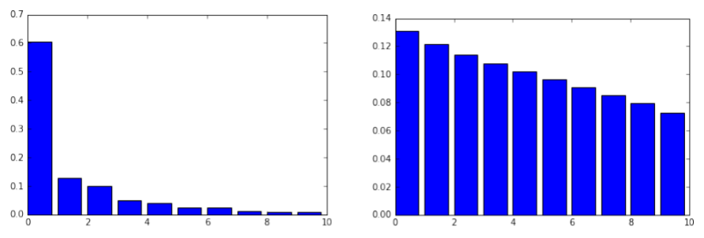
5.1. Identifying the gender subspace
Left: the percentage of variance explained in the PCA of these (gender) vector differences (each difference normalized to be a unit vector).
Right: the corresponding percentages for random unit vectors.
Notes:
정답 단어들과 얼마나 비슷한지를 측정하면 되기 때문에 C_w_i에 대해서만 Probability를 계산하면 된다.

Slide 17

5.2. Direct Bias
N: gender neutral word
g: gender direction (gender subspace)
c: parameter that determines how strict do we want to in measuring bias. (보통 c=1, c=0이면 가장 strict 한 것. => 약간의 bias도 허용 x)
|N|: # words
Notes:
Gender neutral한 word들은 gender subspace 방향으로의 크기가 작겠죠? 즉, 코사인 similarity 값이 작다는 거죠
근데 만약에 neutral 한 word가 gender subspace 방향으로 크기가 크다면 그건 바람직하지 않은 gender information, 즉 bias가 introduce 되었다고 말할 수 있다.

Slide 18
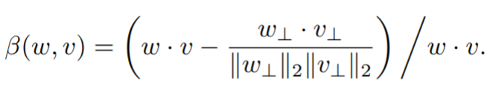
5.3. Indirect Bias
예 – receptionist is closer to softball than football
시간 관계상 skip

Slide 19
6. Debiasing algorithms

Slide 20
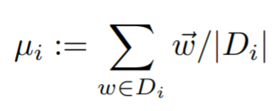
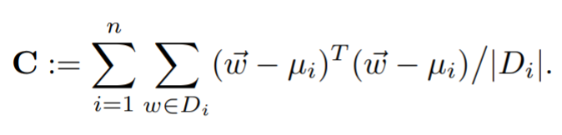
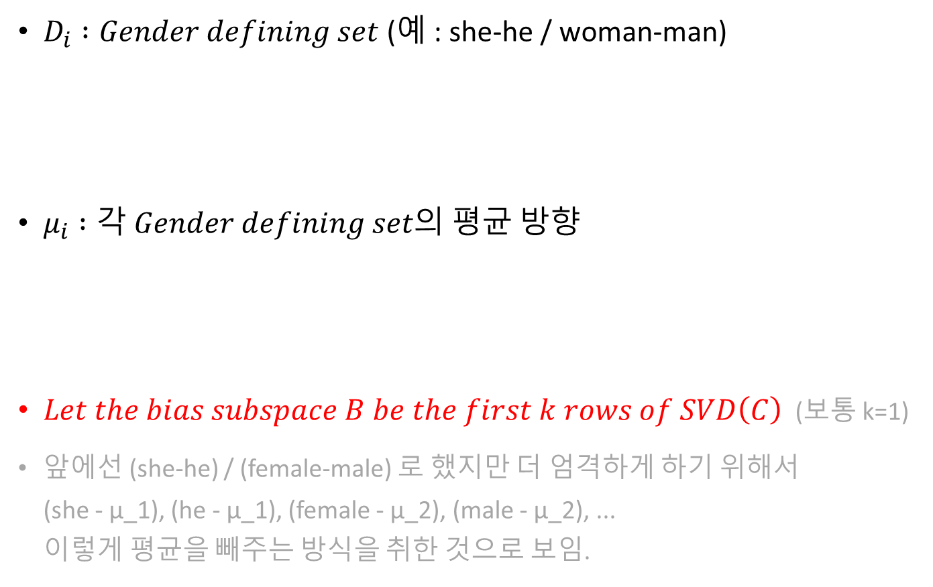
6. Step 1: Identify gender subspace
$D_{i} :Gender defining set$(예 : she-he / woman-man)
$μ_{i} :각 Gender defining set의 평균 방향$
$Let the bias subspace B be the first k rows of SVD\left(C\right)$ (보통 k=1)
앞에선 (she-he) / (female-male) 로 했지만 더 엄격하게 하기 위해서 (she - μ_1), (he - μ_1), (female - μ_2), (male - μ_2), ... 이렇게 평균을 빼주는 방식을 취한 것으로 보임.

Slide 21

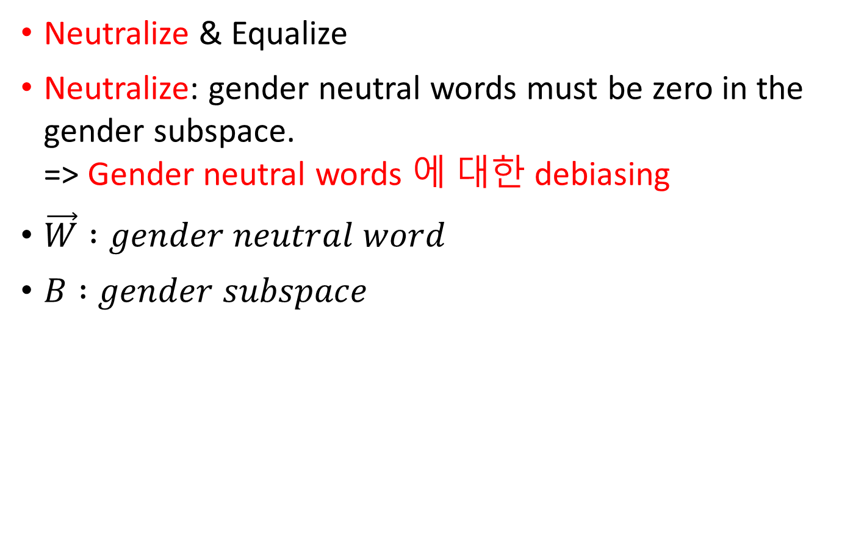
6. Step 2a. Hard debiasing
Neutralize & Equalize
Neutralize: gender neutral words must be zero in the gender subspace. => Gender neutral words 에 대한 debiasing
$\vec{W} :gender neutral word$
$B :gender subspace$

Slide 22
6. Step 2a. Hard debiasing
Neutralize & Equalize
Equalize: perfectly equalizes sets of words outside the subspace and thereby enforces the property that any neutral word is equidistant to all words in each equality set. => Gender specific word pair (e.g. girl & boy) 에서 any gender neutral word (e.g. doctor) 까지의 거리가 같도록 Gender specific words 를 수정하는 것

Slide 23
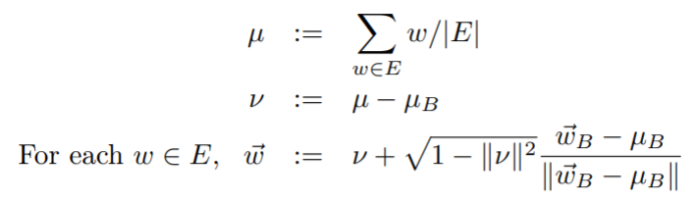
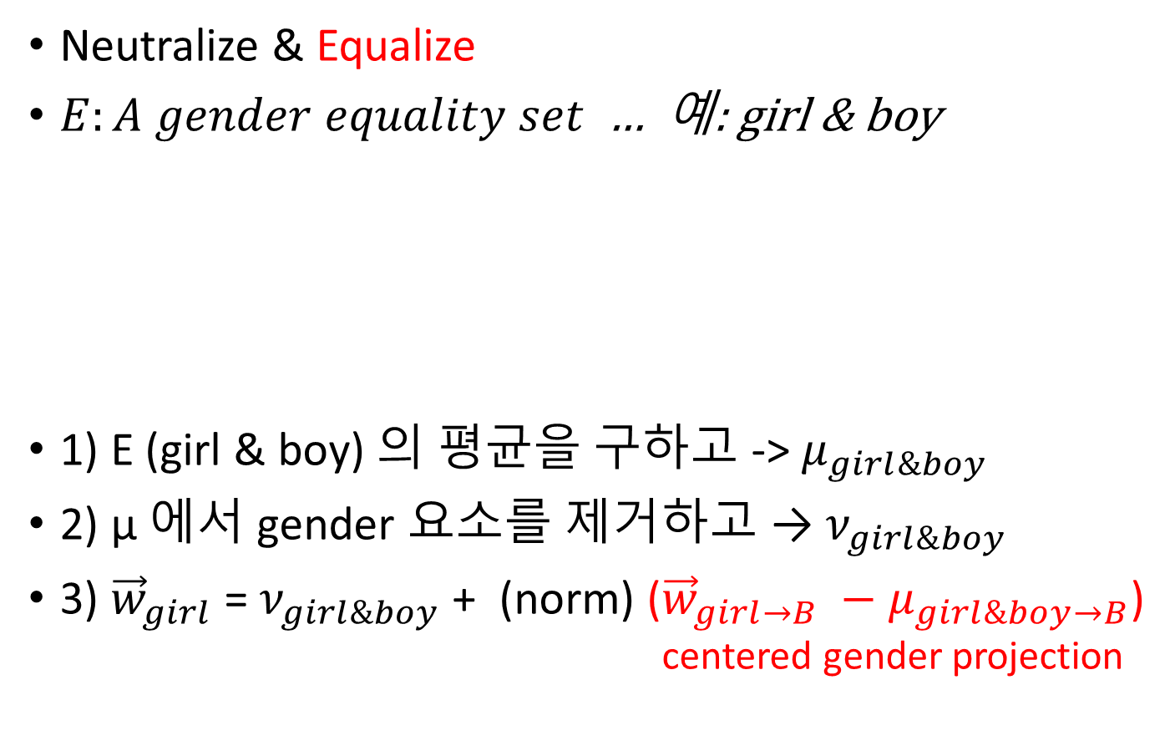
6. Step 2a. Hard debiasing
Neutralize & Equalize
$E:A gender equality set$ … 예: girl & boy
1) E (girl & boy) 의 평균을 구하고 -> $μ_{girl\&boy}$
2) μ 에서 gender 요소를 제거하고 → $ν_{girl\&boy}$
3) ${\vec{w}}_{girl}$ = $ν_{girl\&boy}$+ (norm) (${\vec{w}}_{girl→B} −μ_{girl\&boy→B}$) centered gender projection

Slide 24
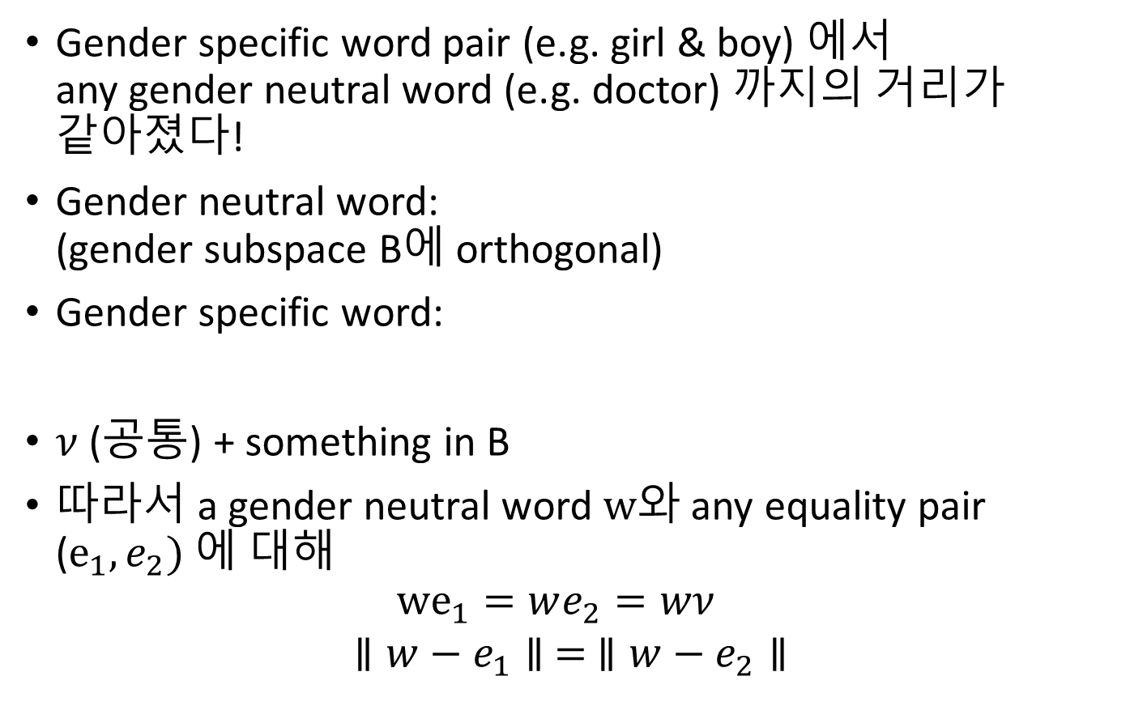
6. Step 2a. Hard debiasing
Gender specific word pair (e.g. girl & boy) 에서 any gender neutral word (e.g. doctor) 까지의 거리가 같아졌다!
Gender neutral word: (gender subspace B에 orthogonal)
Gender specific word:
$ν$ (공통) + something in B
따라서 a gender neutral word $w$와 any equality pair ($e_{1}, e_{2})$에 대해 ${we}_{1}=we_{2}=wν$
$$∥w−e_{1}∥ = ∥w−e_{2}∥$$

Slide 25

6. Step 2b. Soft bias correction
Hard debiasing의 Equalize는 너무 과하다. valuable distinctions도 없어지게 함.
Parameter λ로 correction의 수준을 조절.
시간 관계상 Skip

Slide 26
8. Debiasing results

Slide 27
8. Debiasing results
Direct bias she:he :: A:B 이런 식으로 automatically A, B를 generate. 그리고 crowdsourcing으로 gender stereotype 정도를 물어봄 ⇒ 19%
hard debiasing (neutralize and equalize) 한 다음에 다시 똑같은 방식으로 생성해서 물어보니 ⇒ 6%

Slide 28
9. Discussion

Slide 29
8. Debiasing results
We find a single direction that largely captures gender.
The projection of gender neutral words on this direction enables us to quantify their degree of female- or male-bias.
By equating grandmother and grandfather outside of gender, and since we've removed g from babysit, both grandmother and grandfather are equally close to babysit after debiasing.
... machine learning should not be used to inadvertently amplify these biases.

Slide 30
Thanks!
References Bolukbasi, Tolga, et al. "Man is to computer programmer as woman is to homemaker? debiasing word embeddings.
https://web.stanford.edu/class/archive/cs/cs224n/cs224n.1194/
https://github.com/tolga-b/debiaswe
http://hari-sriblog.blogspot.com/2019/04/man-is-to-computer-programmer-as-woman.html
https://drive.google.com/file/d/1IxIdmreH4qVYnx68QVkqCC9-_yyksoxR/view

